Slide 1
Quora Insincere Questions Classification Leveraging Machine Learning Methods
Name: Priyanka Asnani
Date: April 28, 2022

Slide 2
Introduction
Quora is an American social question-and-answer website based in Mountain View, California.
One of the most popular knowledge sharing platform where people can post questions and get responses from anyone on the Quora community
The key challenge for Quora is to identify ‘insincere’ questions on the platform.
An insincere question is defined as a question intended to make a statement rather than look for helpful answers.

Slide 3
Introduction
Makes disparaging attacks/insults against a specific person or group of people
Isn’t grounded in reality
Based on false information, or contains absurd assumptions
Suggests a discriminatory idea against a protected class of people, or seeks confirmation of a stereotype
Has an exaggerated tone to underscore a point about a group of people

Slide 4
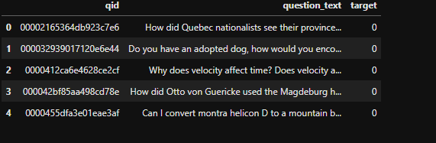
Dataset
Provided by Quora for the online competition on Kaggle https://www.kaggle.com/competitions/quora-insincere-questions-classification/overview
The task was to predict whether a question asked on Quora is sincere or not
The data consists of 1.3 million observations and 3 features.

Slide 5
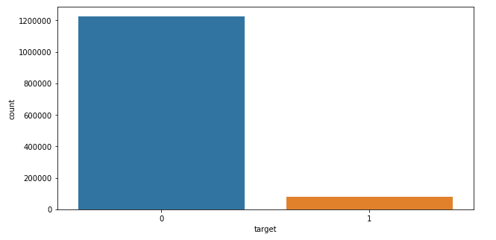
Dataset
The dataset is extremely imbalanced
Unequal distribution of classes
Only 6% of observations are Insincere

Slide 6
Oversampling & Stratified Sampling (Discussion in chapter 5, section 5.5 in DBMA-R Book)
Observations for rare class not enough to yield useful information about what distinguish them from dominant class
Maintain equal proportion of classes in the training set by oversampling the records from the rare class
Maintain same proportion of classes in the testing set as in the original dataset using Stratified sampling
Training set: 40,000 observations for ‘insincere’ and 40,000 observations for ‘sincere’ class
Testing set: 40,000 observations for ‘insincere’ and 600,000 observations for ‘sincere’ class

Slide 7
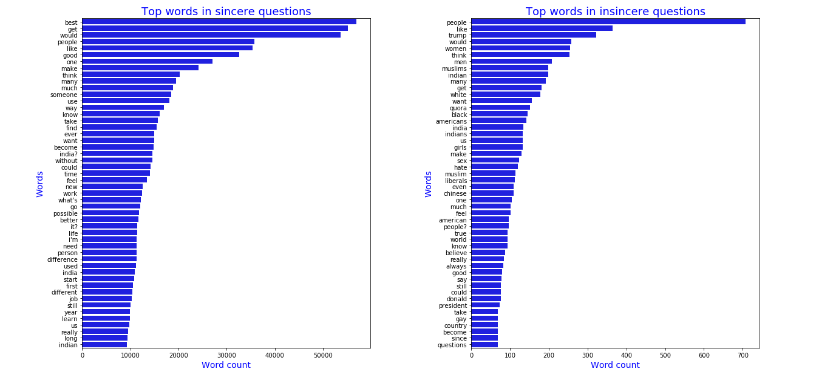
Dataset

Slide 8
Data Preprocessing
Tokenization: The process of splitting a text sequence into words
Expand Contractions: Contractions include words such as you’ll, I’d, can’t, won’t, don’t, etc. We wrote regular expressions to expand on the contractions.
Remove Punctuations & Numbers
Remove Stop words
Lemmatization: Using root words instead of the words itself. For example, words like dancing, dances, danced will transform to dance

Slide 9
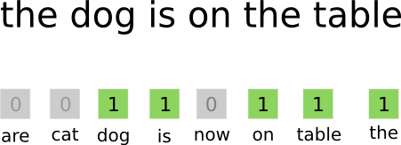
Textual Representations – Bag of words
Bag of words featurization indicates the presence or absence of individual words
"the beer is bad, not good" and the sentence "the beer is good, not bad" have the same featurization because they have the same words, even though they have very different meanings.

Slide 10
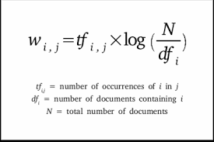
Textual Representations – TF-IDF
TF-IDF featurization assumes that the best descriptive terms for a given document are those that occur very often in the given document (term frequency) but not much in other documents (inverse document frequency)
words with high tf-idf will do well in distinguishing between documents

Slide 11
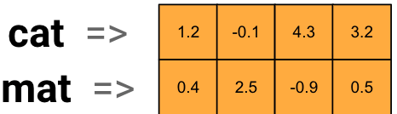
Textual Representations – Word Embeddings
Bag-of-words featurization (also known as one-hot vectors) provides no information about how words are related to each other.
For instance, the words ”play”, ”playing”, and ”igloo” would have one-hot features [1,0,0], [0,1,0], and [0,0,1], which are all equally different, even though ”play” and ”playing” should intuitively have very similar representations.
A commonly used alternative to one-hot vectors is word embeddings

Slide 12
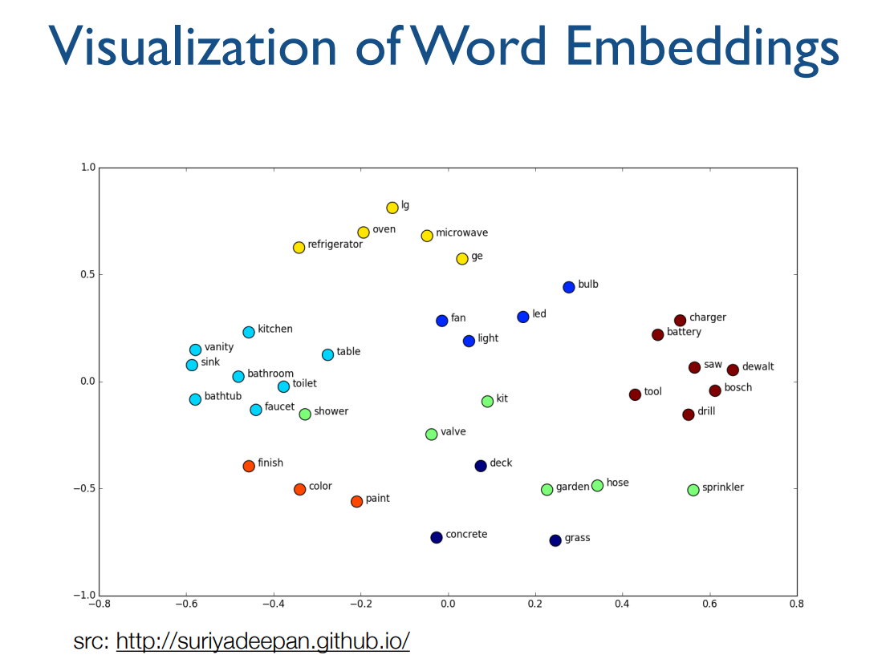
Textual Representations – Word Embeddings

Slide 13
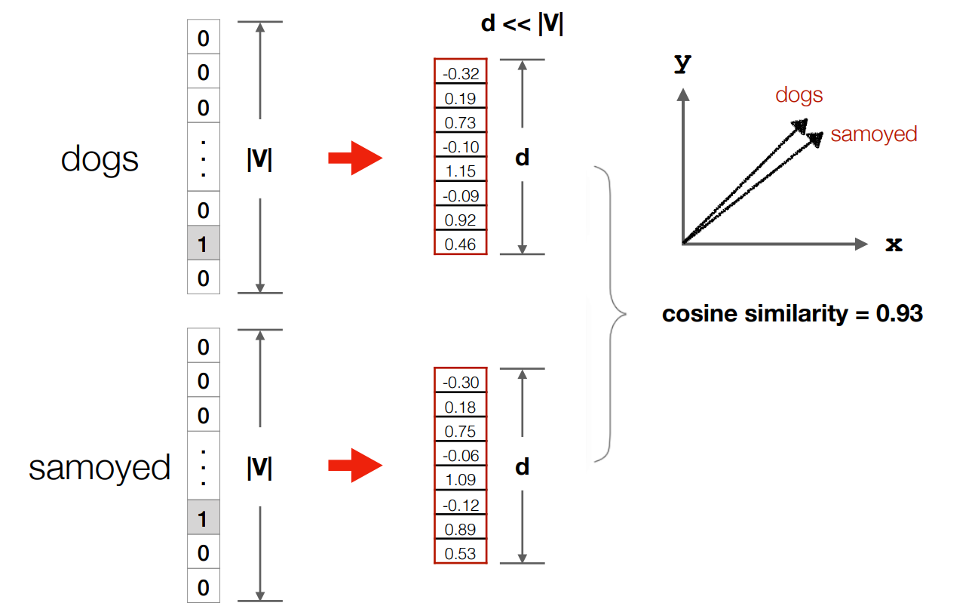
Textual Representations – Word Embeddings
Limit

Slide 14
Machine Learning Classification Models
Naive Bayes
Logistic Regression
Support Vector Machines
Decision Tree
Random Forest
Voting Classifier

Slide 15
Bidirectional Encoder Representation from Transformers (BERT)
BERT (Devlin et al. 2018) is the state-of-the-art natural language model published by the Google AI Language team in 2019
BERT, unlike other popular embedding models is a context- based model
For example, the word ’bank’ in sentence ”We got loan from the bank” refers to the banking institution, while in sentence ”She sat on the riverbank”, the word ’bank’ refers to the riverbank. So, for word ’bank’ it will generate two different embeddings.
BERT is pre-trained from unlabeled Wikipedia (2,500M words), and Book corpus (800M words) to obtain contextual embeddings.

Slide 16
Bidirectional Encoder Representation from Transformers (BERT)
The model is based on Transformers (Vaswani et al., 2017) which uses attention mechanism.
To compute the representation of word, the self-attention mechanism relates the word to all other words in the sentence.
The self-attention mechanism in the transformer allows BERT to be fine-tuned for many downstream tasks such as text classification.

Slide 17
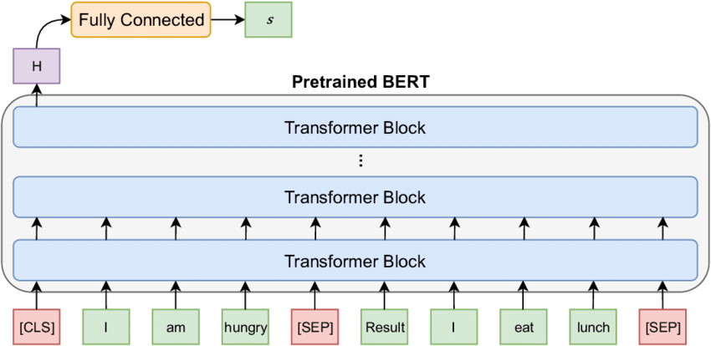
Bidirectional Encoder Representation from Transformers (BERT)
The fine-tuning tasks take much less time to train a new set of training data than training the model from scratch.

Slide 18
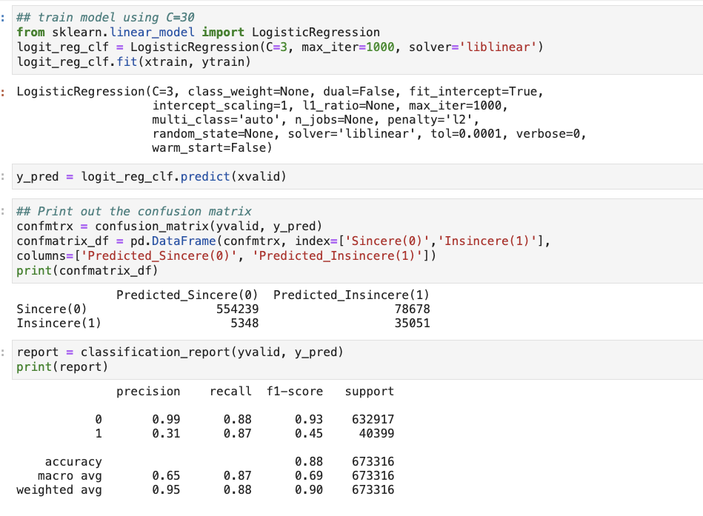
Python Code

Slide 19
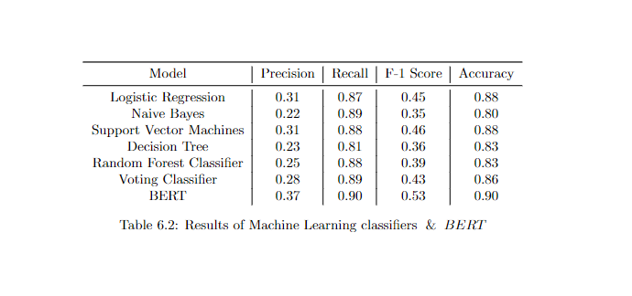
Results
Recall (Sensitivity): proportion of positives that are correctly predicted positive.
Recall = TP/TP+FN
Precision: proportion of predicted positives that are correctly classified.
Precision = TP/TP+FP
F-1 Score: measures the weighted average of Precision and Recall.
F-1 Score = 2 * (Recall * Precision)/ Recall + Precision
Accuracy: measures the proportion of instances that were classified correctly.
Accuracy = TP + TN/TP+FN + TN + FP

Slide 20
Questions?

